Slide 1


Assignment Agent
AI-Based Assignment Evaluation System
Role: Backend & Database Engineer
Automating the evaluation process to save time, ensure consistency, and provide instant feedback to learners.

Slide 2
CHALLENGE
The Problem We're Solving
Time-Consuming Process
Format Complexity
Manual assignment evaluation consumes significant hours of educators' time, limiting their ability to focus on teaching and student support.
Evaluating diverse file formats—code files, documents, presentations—requires different tools and approaches, creating inconsistency.
Limited Feedback
Scalability Issues
Traditional methods struggle to provide detailed, actionable feedback quickly, leaving students waiting for guidance.
As class sizes grow, maintaining evaluation quality and turnaround time becomes increasingly challenging with manual processes.

Slide 3



Project Overview
Assignment Agent revolutionises the evaluation process by automating assignment assessment across multiple submission formats. The system intelligently processes file uploads, GitHub repositories, and PowerPoint presentations, leveraging AI to deliver consistent, detailed feedback.
File Uploads
Built on a robust backend architecture with comprehensive database support, the platform ensures scalability, reliability, and precision in every evaluation.
GitHub Integration
PPT Analysis

Slide 4





ARCHITECTURE
System Architecture
Frontend
Submission interface
Backend APIs
Validation & orchestration
AI Engine
Content evaluation
Database
Persistent storage
Output
Results & feedback

Slide 5
Core Features
1
2
Multi-File Upload Handling
GitHub Repository Analysis
Seamlessly processes diverse file types including source code, documents, and compressed archives with intelligent validation and parsing.
Clones and analyses entire repositories, evaluating code structure, commit history, documentation, and adherence to best practices.
3
4
PPT Content Extraction
Automated Scoring & Feedback
Extracts and evaluates presentation content, assessing structure, clarity, visual design, and alignment with assignment requirements.
Generates detailed marks with comprehensive feedback, highlighting strengths, identifying areas for improvement, and suggesting concrete next steps.

Slide 6


MY ROLE
Backend Design & Implementation
RESTful API Development
Designed and implemented comprehensive APIs for submission handling, supporting file uploads, GitHub integration, and PPT processing with robust authentication.
Processing Logic
Built unified processing pipelines for disparate input types, ensuring consistent validation, extraction, and transformation across all submission formats.
AI Integration Workflow
Orchestrated the evaluation workflow, managing AI model interactions, prompt engineering, and result aggregation for accurate assessment delivery.
Error Handling & Logging
Implemented comprehensive error handling with detailed logging and monitoring, ensuring system reliability and facilitating rapid issue resolution.

Slide 7
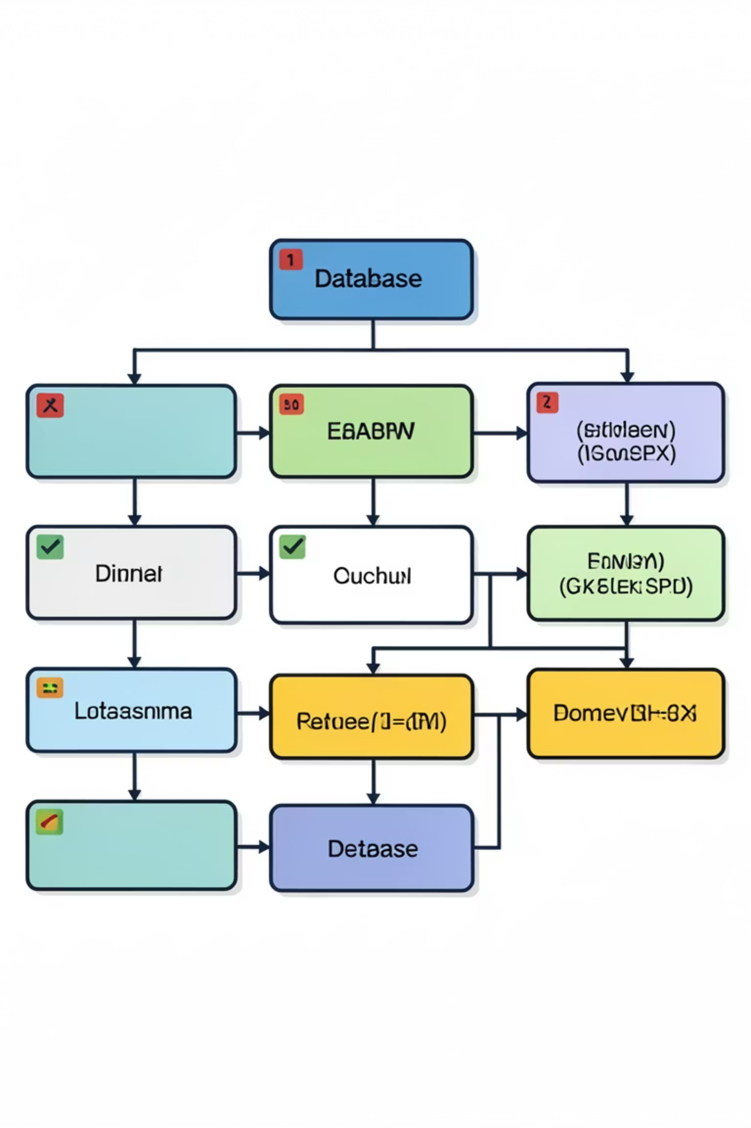
Database Design
Core Tables
Evaluation Storage
Users: Student and instructor profiles with authentication credentials
Results: Scores, marks breakdown, and overall assessment
Assignments: Assignment definitions, requirements, and rubrics
Feedback: Detailed comments, suggestions, and improvement areas
Submissions: Submission metadata, timestamps, and status tracking
History: Audit trail for resubmissions and versioning
Files: File metadata, storage locations, and type information
Scalable, normalised schema designed for high performance and data integrity across concurrent evaluations.

Slide 8
Evaluation Workflow
01
02
03
Submission Received
Input Validation
Content Extraction
User submits assignment via web interface
Backend validates format, size, and requirements
Files processed and content extracted
04
05
AI Evaluation
Results Delivered
Content analysed against rubric criteria
Scores and feedback stored and returned

Slide 9
Challenges & Solutions
Multiple File Formats
Fair Evaluation
Challenge: Handling diverse submission types—code, documents, presentations—each requiring different parsing approaches.
Challenge: Ensuring AI provides consistent, unbiased assessments across different submission styles and content types.
Solution: Developed a unified processing engine with format-specific handlers and standardised output interfaces for consistent downstream processing.
Solution: Crafted detailed AI prompts with clear rubrics, established evaluation criteria, and implemented result validation to maintain assessment quality.
Large Repositories
Data Consistency
Challenge: Processing extensive GitHub repositories efficiently without timeouts or resource exhaustion.
Challenge: Maintaining data integrity across concurrent evaluations and ensuring reliable storage of results.
Solution: Implemented optimised cloning strategies, selective file analysis, and asynchronous processing to handle repositories of any size reliably.
Solution: Designed a structured database schema with transaction management, foreign key constraints, and comprehensive indexing for data reliability.

Slide 10

Thank You
Questions & Discussion
I welcome your questions about the Assignment Agent system, technical implementation details, or future enhancement opportunities.

